Slide 1

TRAFFIC JAM PROJECT
By Niels Blonk, Danny Bui, Laura Holtus, Marc de Jong, David Koymans, Daan de Munck, Ravan Strijker and Elio Verhoef

Slide 2
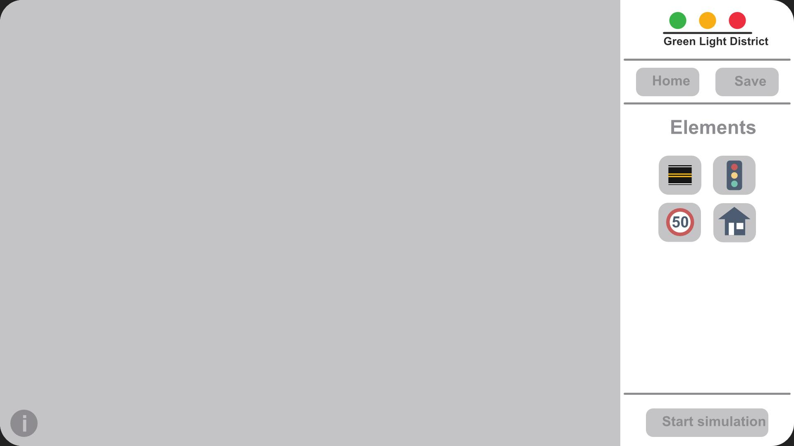
Recap: Project goals
Building road junctions
Realistic simulations
Car types
Driver behavior
Traffic rules

Slide 3
What we’ve been working on:
The infrastructure of our project
User Interface
Grid
Roads
Car
AI

Slide 4
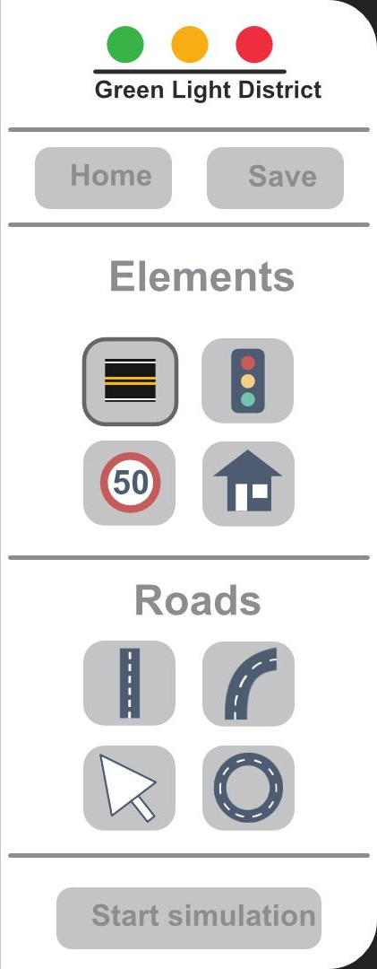
Project goals
Building road junctions
Realistic simulations
Car types
Driver behavior
Traffic rules

Slide 5
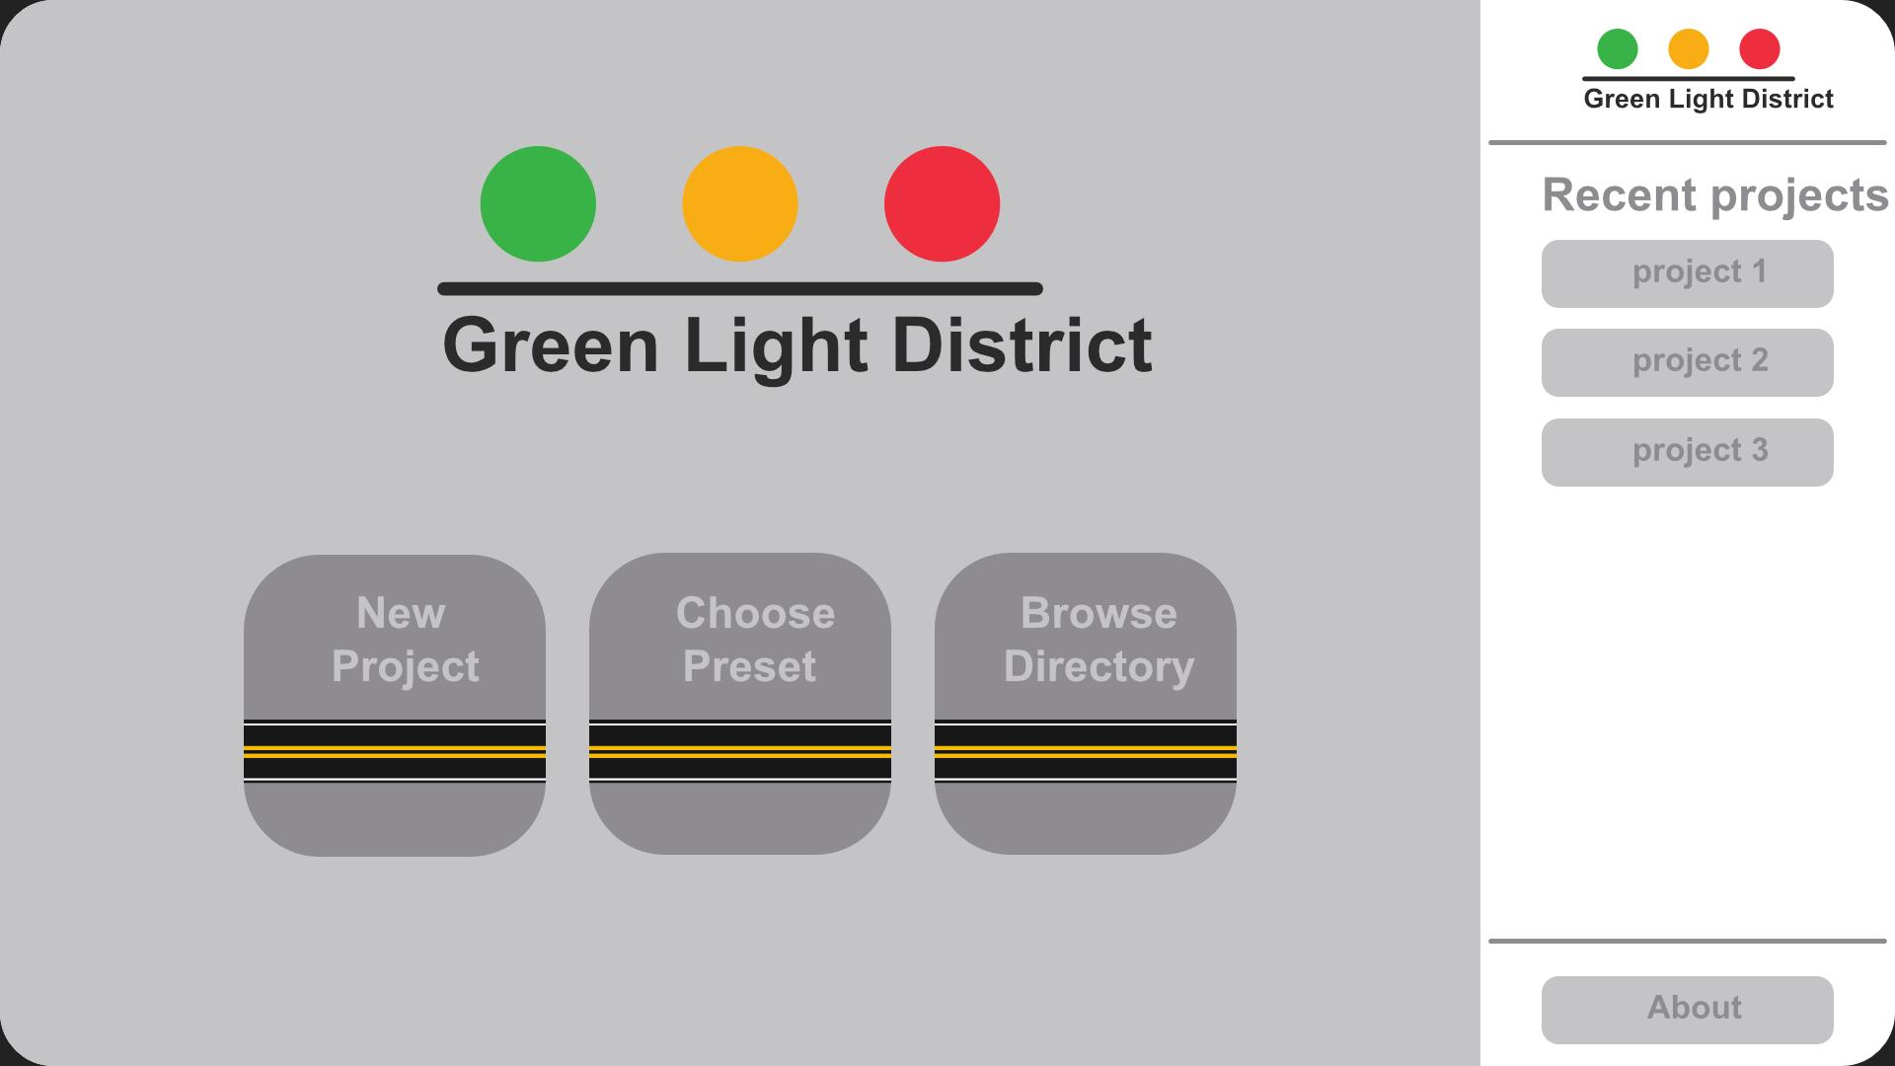
User Interface
Custom form class
Custom buttons
Demonstration

Slide 6
Grid
GridController
Gridpoint

Slide 7
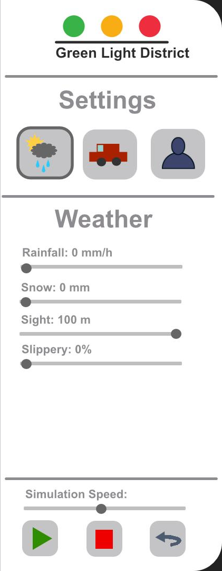
Project goals
Building road junctions
Realistic simulations
Car types
Driver behavior
Traffic rules

Slide 8
Road
A road: two points, a direction
and the number of lanes
Roadcontroller
Road
DrivingLane

Slide 9
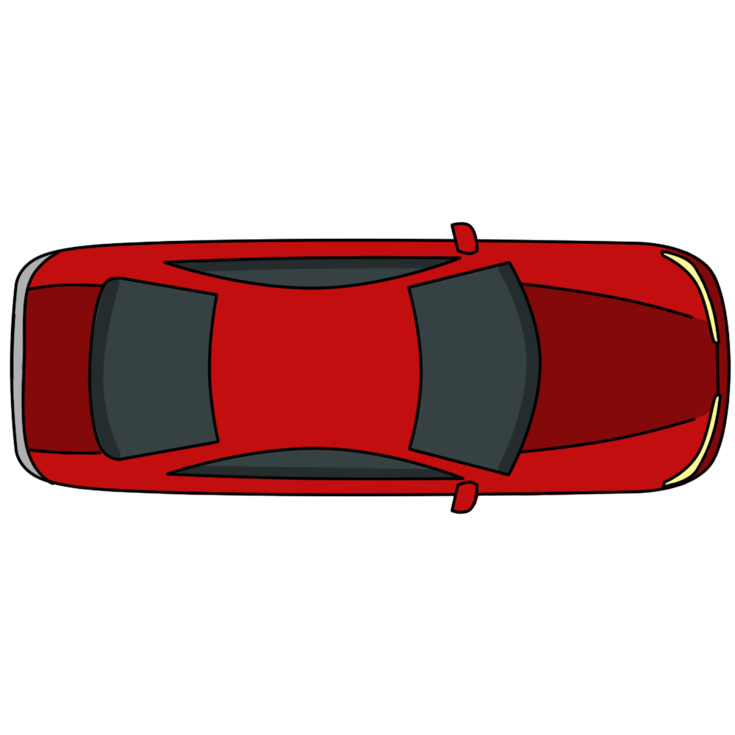
Car
A vessel for the AI
Commands
Physics

Slide 10
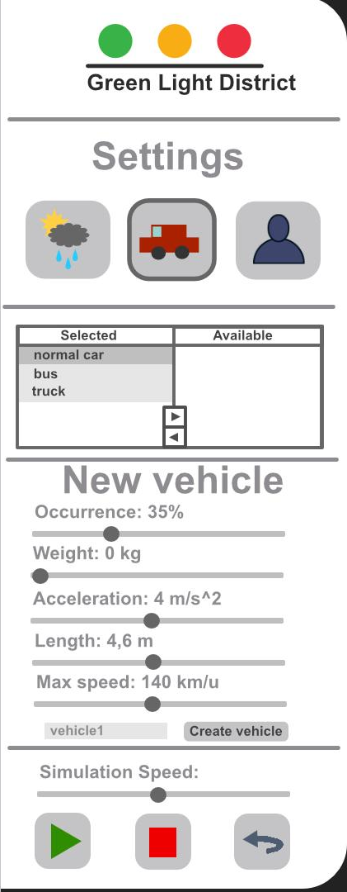
Project goals
Building road junctions
Realistic simulations
Car types
Driver behavior
Traffic rules

Slide 11
AI
Path-finding Algorithm
Character in the form of variables

Slide 12
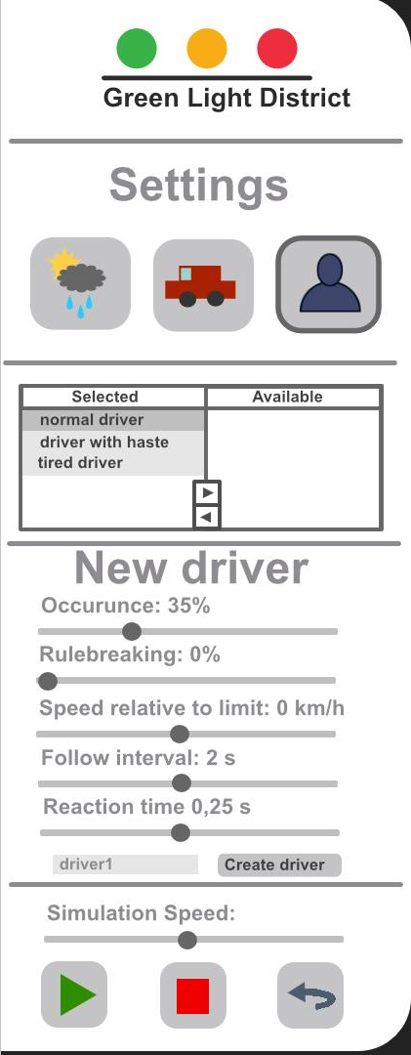
Project goals
Building road junctions
Realistic simulations
Car types
Driver behavior
Traffic rules

Slide 13
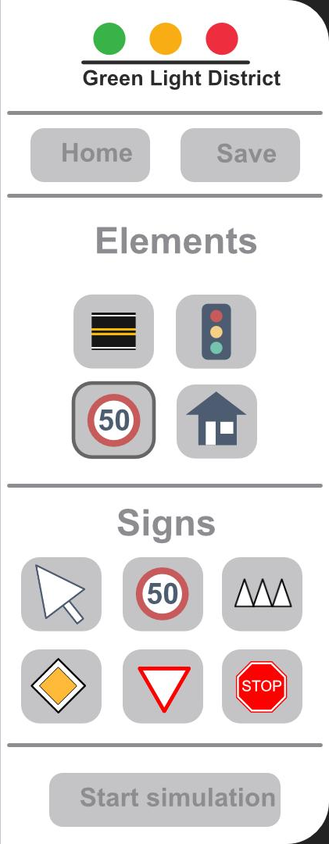
Project goals
Building road junctions
Realistic simulations
Car types
Driver behavior
Traffic rules

Slide 14
AI
Path-finding Algorithm
Character in the form of variables
Still unfinished
Demonstration

Slide 15
Questions?

